Slide 1
Email Spam Classifier Project
Submitted By-
Madhurima Srivastava
Internship-30

Slide 2
ACKNOWLEDGMENT
I would like to express my special thanks of gratitude to “FlipRobo Technologies” that made this project possible. I would like thank my SME Mr. Mohd Kashif for his guidance in building this project. I would also like to thank Data Trained Institution to making me capable of making proper decisions in the field of damascene and Machine learning. Lastly, I would like to thank my parents to make all of this happen.

Slide 3
INTRODUCTION
Business Problem Framing
You were recently hired in Start-up Company and you were asked to build a system to identify spam emails. We have to build a machine learning model that will predict if the email is ‘HAM’ or ‘SPAM’.
Conceptual Background of the Domain Problem
Natural Language processing or NLP is a subset of Artificial Intelligence (AI), where it is basically responsible for the understanding of human language by a machine or a robot.

Slide 4
Motivation for the Problem Undertaken
This is a Natural Language Processing Problem and this will lead us to create highly communicative machines using human-native language.

Slide 5
Analytical Problem Framing
Mathematical/ Analytical Modelling of the Problem
The Problem is of Classification.
The Data consists of 2 features in the dataset. There are more than 2.7K samples in the dataset. All the Data is of string datatype.
Use appropriate algorithms to build up the model.
The data is in English language which also consists of numbers and special characters.
The dirty data should be cleaned in order to retrieve meaning from the data
There are 62 records with missing values in the dataset.
Also create word dictionary and word cloud for further and future analytics.
The target classes has 20:80 ratio for spam: ham
The target has 2 classes only, it is a binary classification problem. Using appropriate metrics for scoring and evaluations .

Slide 6
Data Sources and their formats
The data was provided by the client to “FlipRobo Technologies”. The data is in the form of a comma separated file (CSV). The data
i.e. the features and the target are in the single file.
Data Pre-processing Done
The Data pre-processing done is as follows:
Removing Stop words from the data.
Removing punctuations and other special characters from the records
Some more granular cleaning for treating hyphen and underscore joined words.
Removing the words which are less than 3 letters in length
Perform Stemming using PorterStemmer class from sklearn library
Perform Lemmatizing using WordNet class from sklearn library
Further, we remove all the words which do not convey any meaning in the context of the English Language
Vectorize the data using tf-idf Vectoriser

Slide 7
Model/s Development and Evaluation
Identification of possible problem-solving approaches (methods)
Describe the approaches you followed, both statistical and analytical, for solving of this problem.
Testing of Identified Approaches (Algorithms)
Listing down all the algorithms used for the training and testing.
The Algorithms used for testing, training and Validating the models are as follows:
Logistic Regression
SVC (with an rbf kernel)
Decision Tree
K Nearest Neighbour
Naïve Bayes
Random Forest
Gradient Boosting

Slide 8
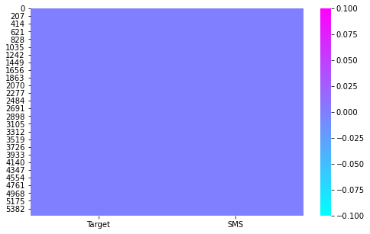
Data Integrity check
NO MISSING VALUES FOUND

Slide 9
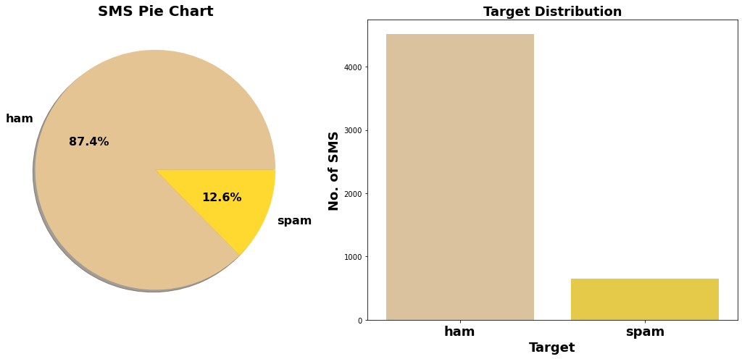
Exploration of Target Feature
Around 87.4% SMS are HAM while 12.6% SMS are SPAM in nature.

Slide 10
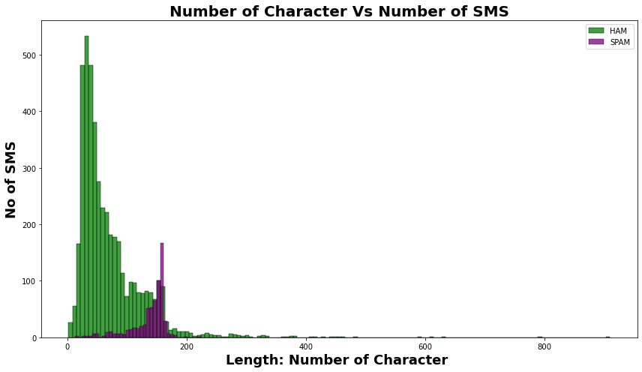
Number of character in Spam sms is comparetively much high than Non-Spam (ham) sms.
On average each ham sms contain 71 character, 17 words and 2 sentences.

Slide 11
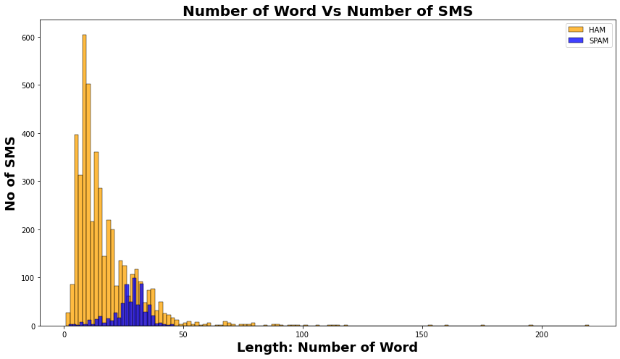
Number of words vs number of SMS
Number of Word in Spam sms is comparetively much high than Non-Spam (ham) sms.
On average each spam sms contain 138 character, 27 words and 3 sentences.

Slide 12
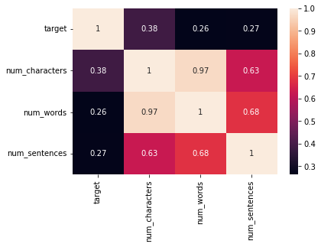
Label Encoding of Target Variables

Slide 13
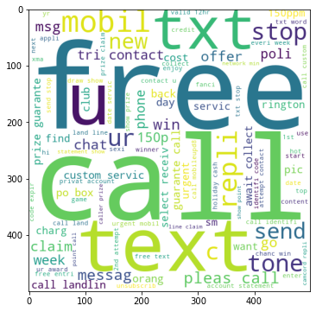
Word Cloud
Word Cloud is a visualization technique for text data wherein each word is picturized with its importance in the context or its frequency.
The more commonly the term appears within the text being analysed, the larger the word appears in the image generated.
The enlarged texts are the most number of words used there and small texts are the less number of words used.

Slide 14
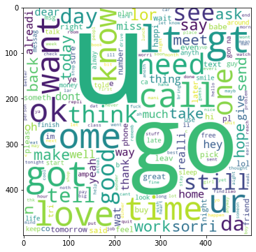
This is the word Cloud for the Ham messages

Slide 15
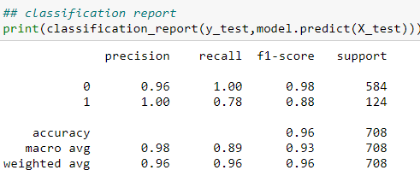
Interpretation of the Results
This is the classifications report on the test set. Since we have high imbalance in our target classes we used AUC_ROC to evaluate the model

Slide 16
CONCLUSION
Key Findings and Conclusions of the Study
NLP gets hard are humans are not used to typing as proper grammar these years.
Sweet spot should be found between whether to pick stemming or lemmatization or both.
Naïve Bayes algorithms are quicker than rest of the algorithms.
Learning Outcomes of the Study in respect of Data Science
List down your learnings obtained about the power of visualization, data cleaning and various algorithms used. You can describe which algorithm works best in which situation and what challenges you faced while working on this project and how did you overcome that.

Slide 17
Outcomes of the Study:
Almost 90 percent of the time is spent of data cleaning and data modelling.
You do not get a Gaussian distribution in real-word problem.
NLP becomes difficult due to sloppy use of language by humans
This also created issue while teaching to machines
Algorithms like Support Vector Machines and K nearest neighbours may take a long time to converge on a Hugh dataset like this.
Naïve Bays is very quick as of converging rate.
Limitations of this work and Scope for Future Work
More data is always appreciated
The model could be integrated with the any email app used by the Data Analysts and Developers for easy spam filtering decision.
The model could be placed into a Continuous Integration and Continuous Deployment for online training environment.

